Slide 1
Cultural Experience 文化体験 【Sake & Tea・酒と茶】

Slide 2
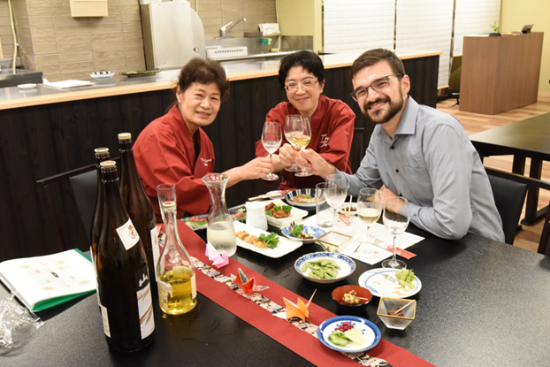
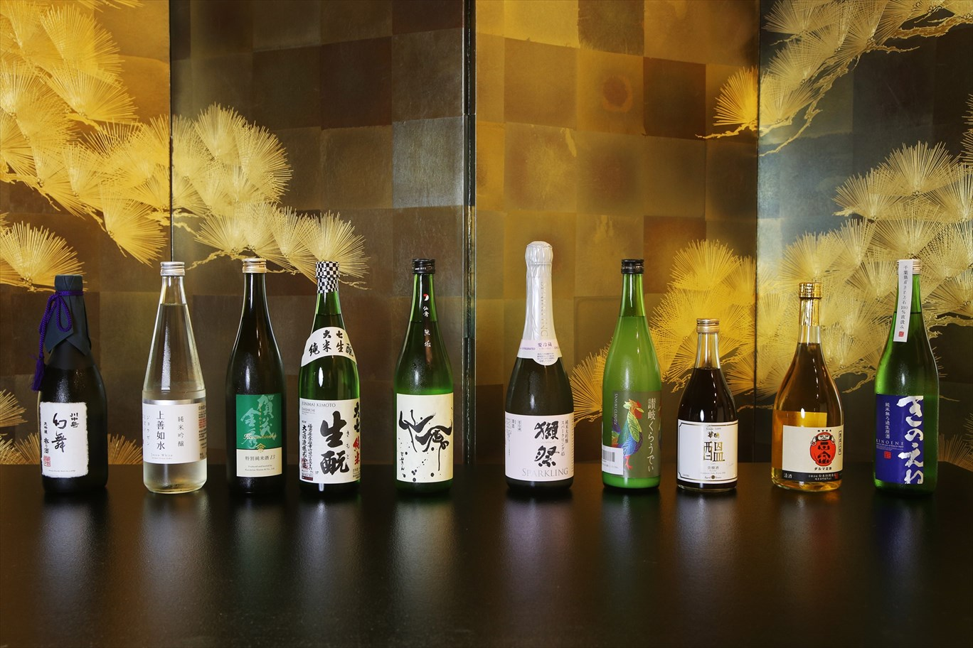
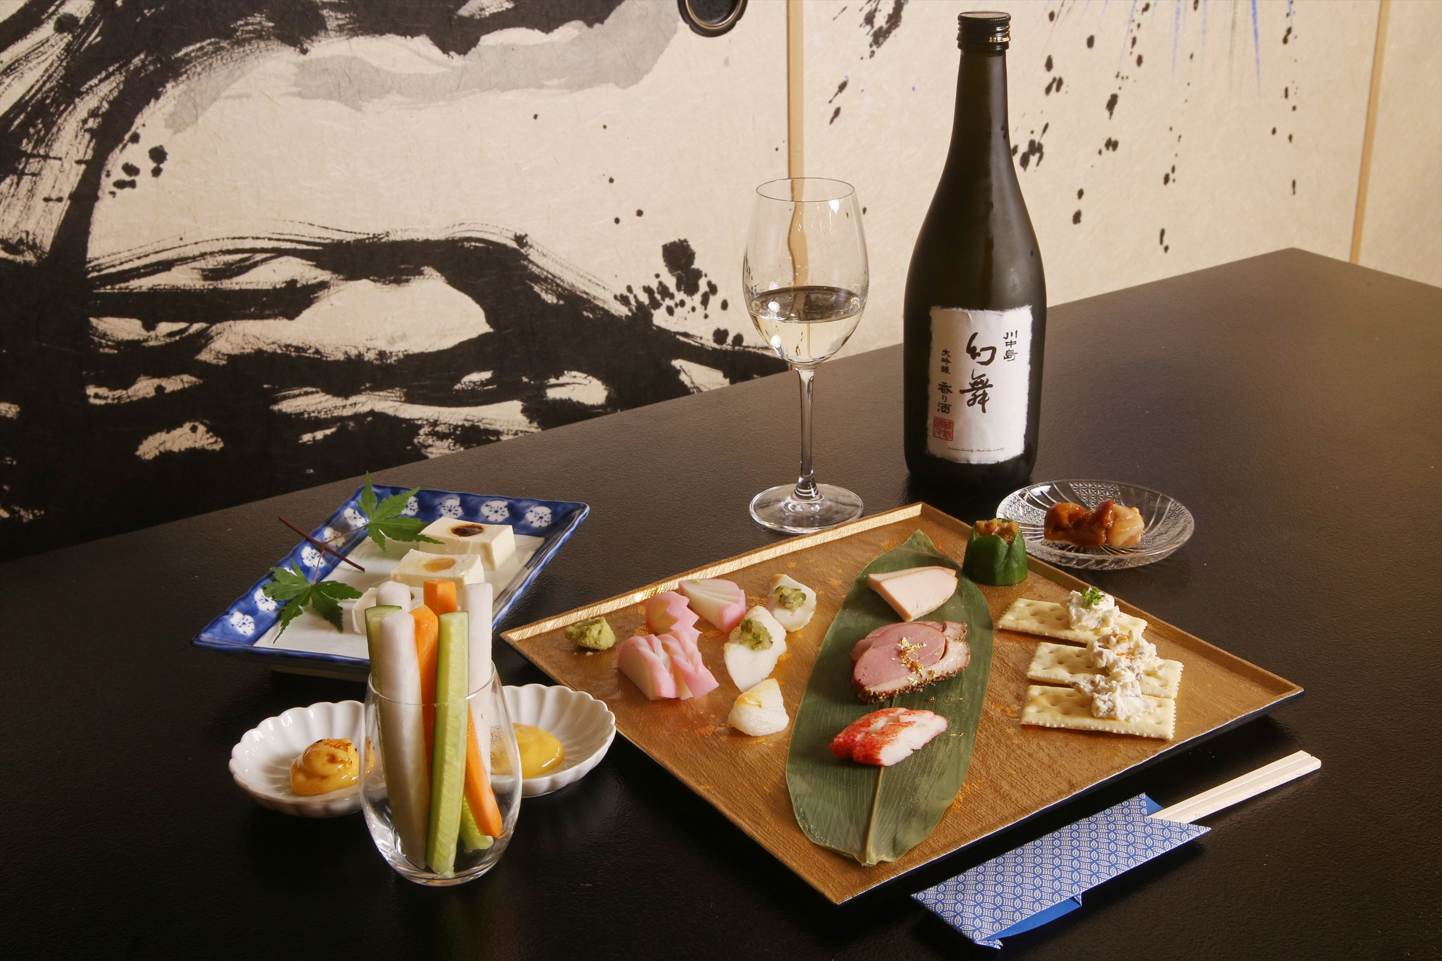
C005 7 Kinds of Sake Tasting with Complementary Foods 日本酒7種飲み比べと厳選7つの料理体験

Slide 3
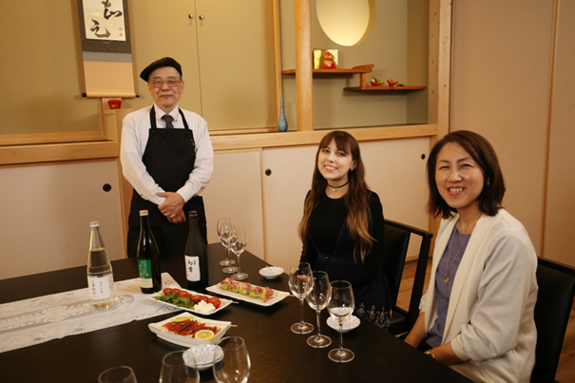
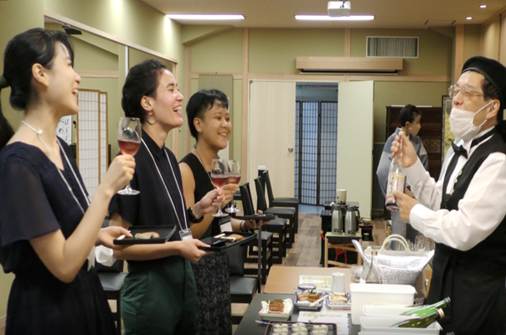
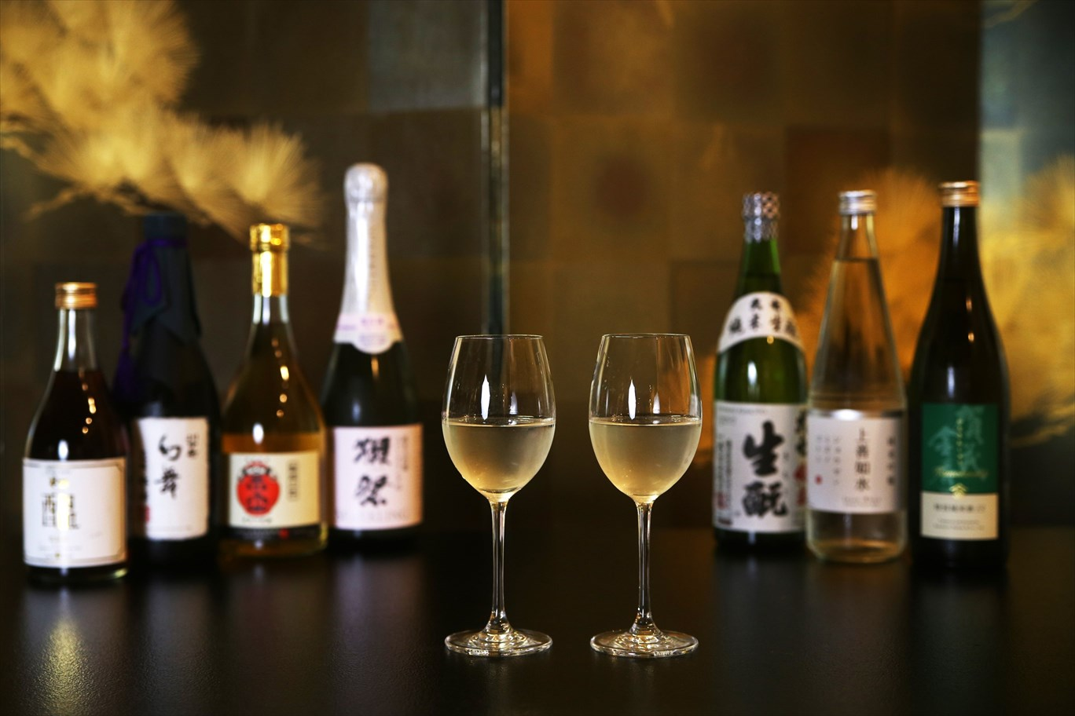
C006 5 Kinds of Sake Tasting with Complementary Foods 日本酒5種飲み比べと厳選5つ料理体験

Slide 4
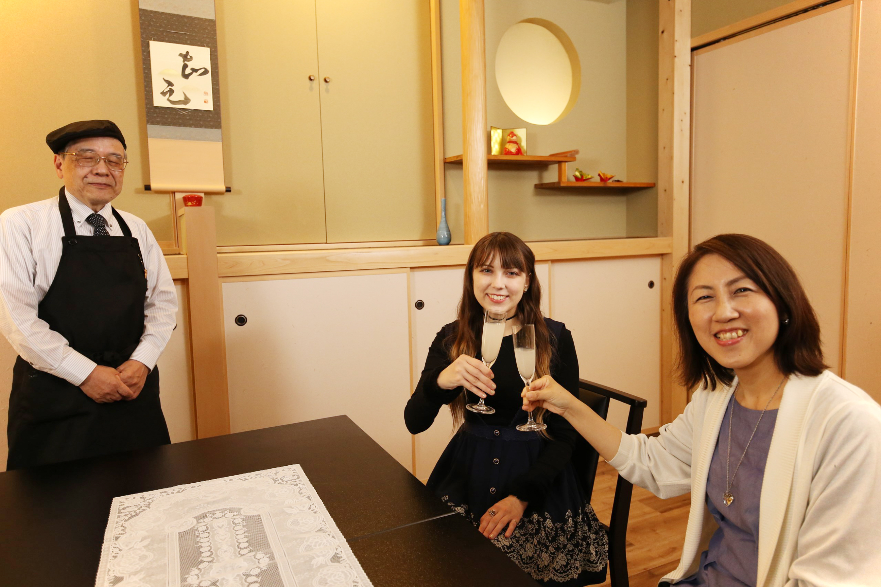
C007 3 Kinds of Sake Tasting Experience 日本酒3種飲み比べ

Slide 5
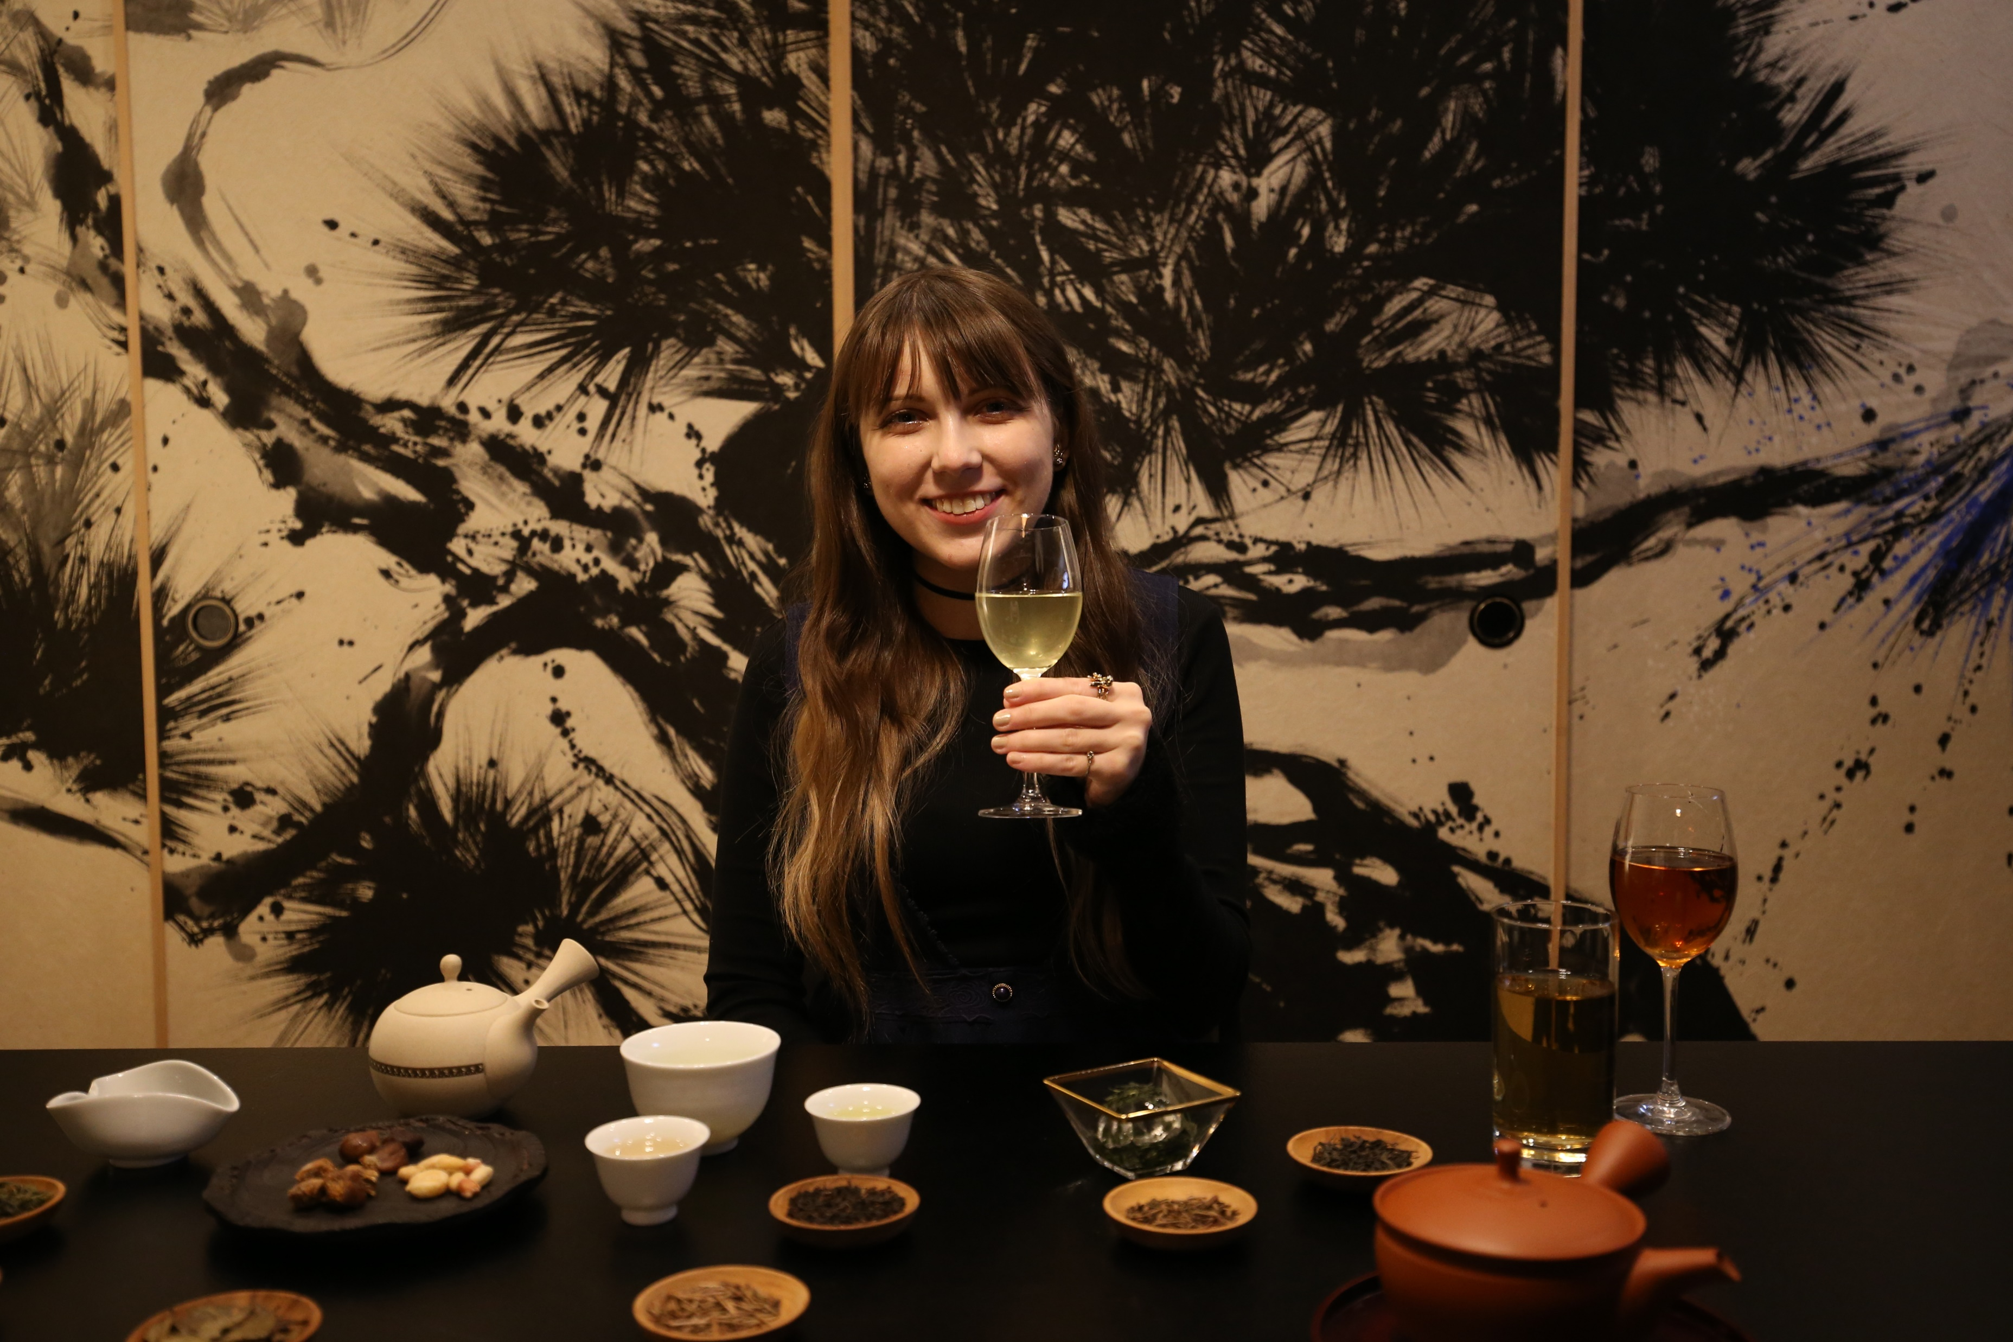
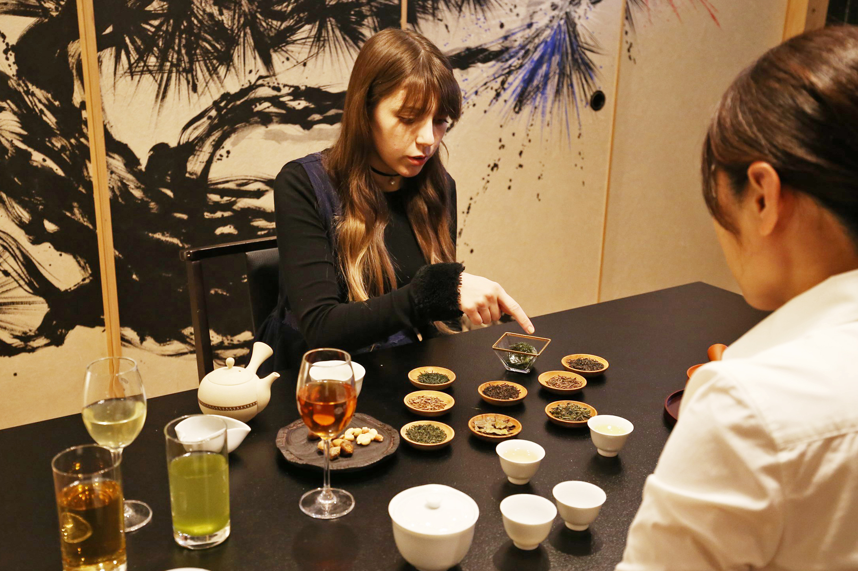
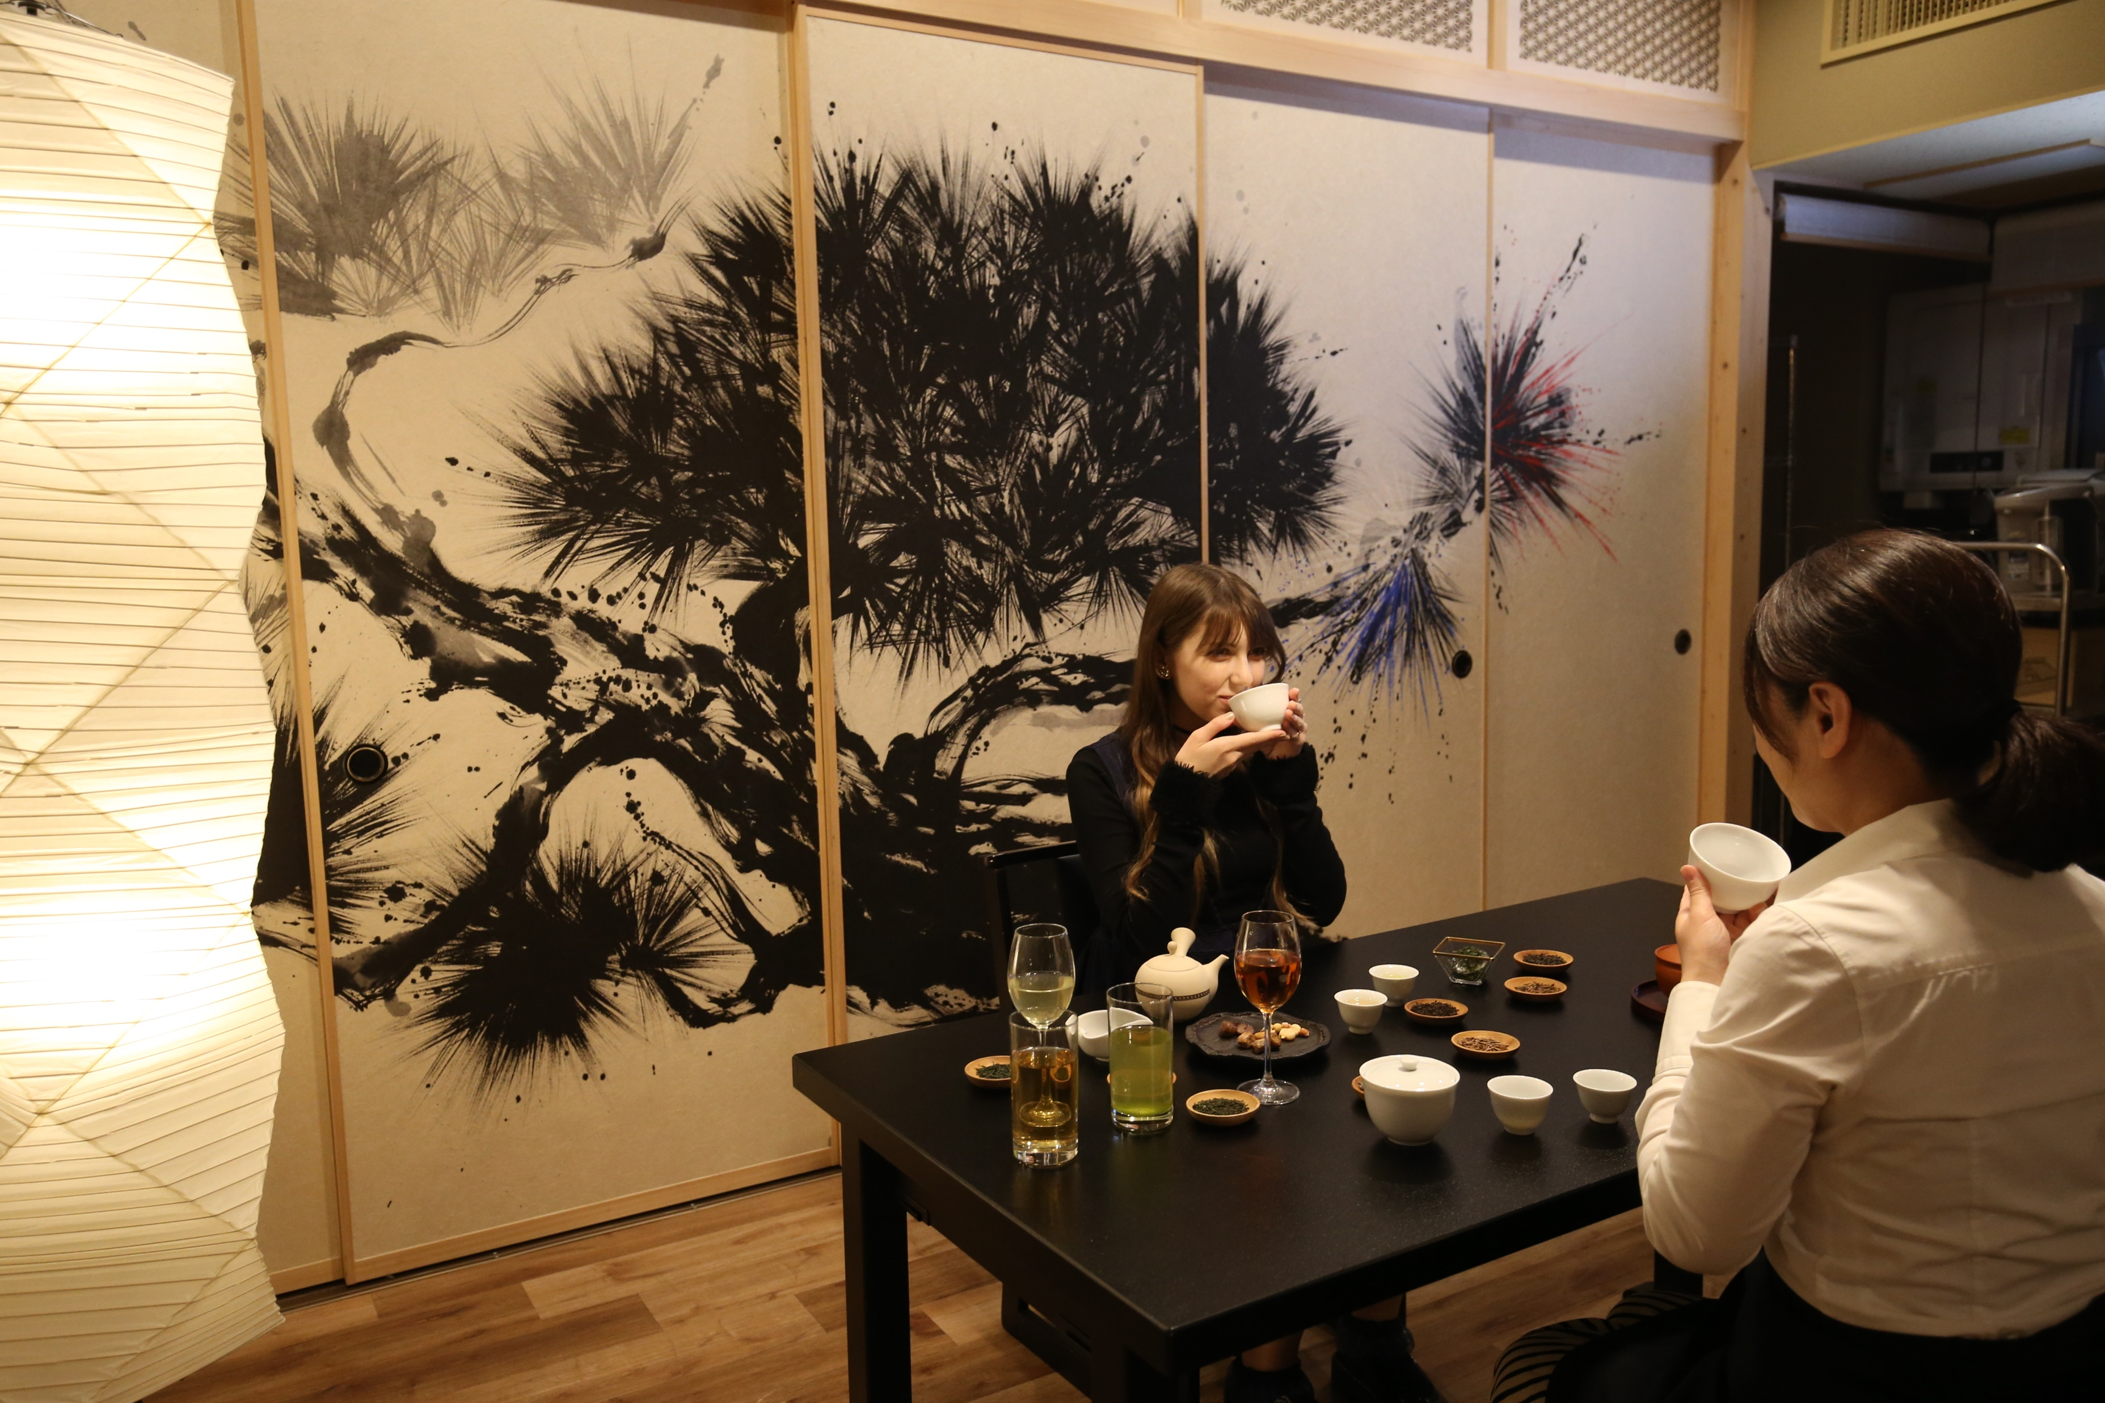
C008 7 Kinds of Japanese Tea Tasting Experience 日本茶7種飲み比べ体験

Slide 6
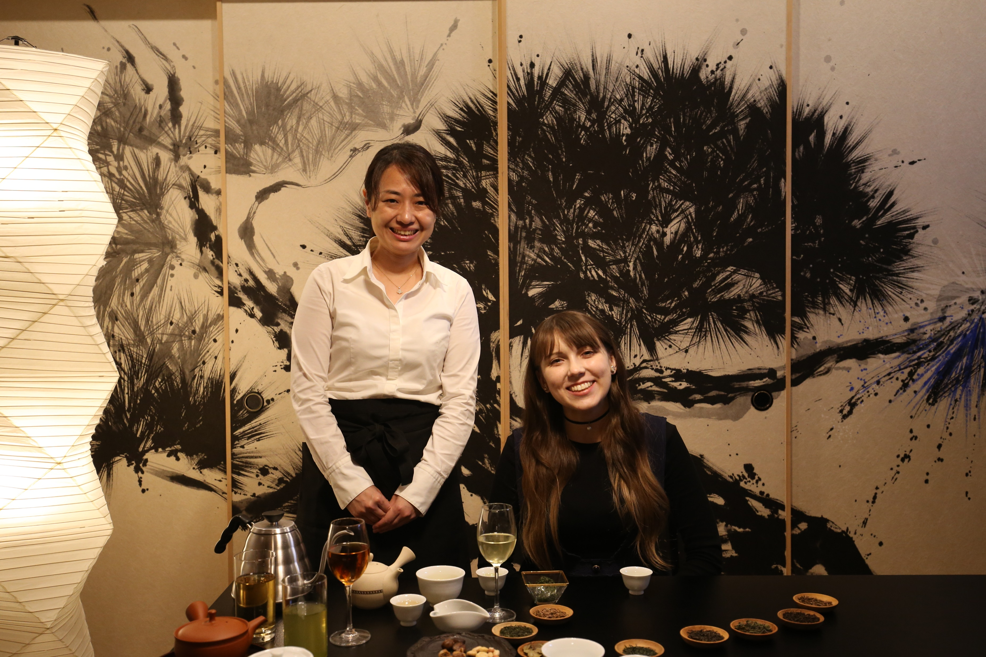
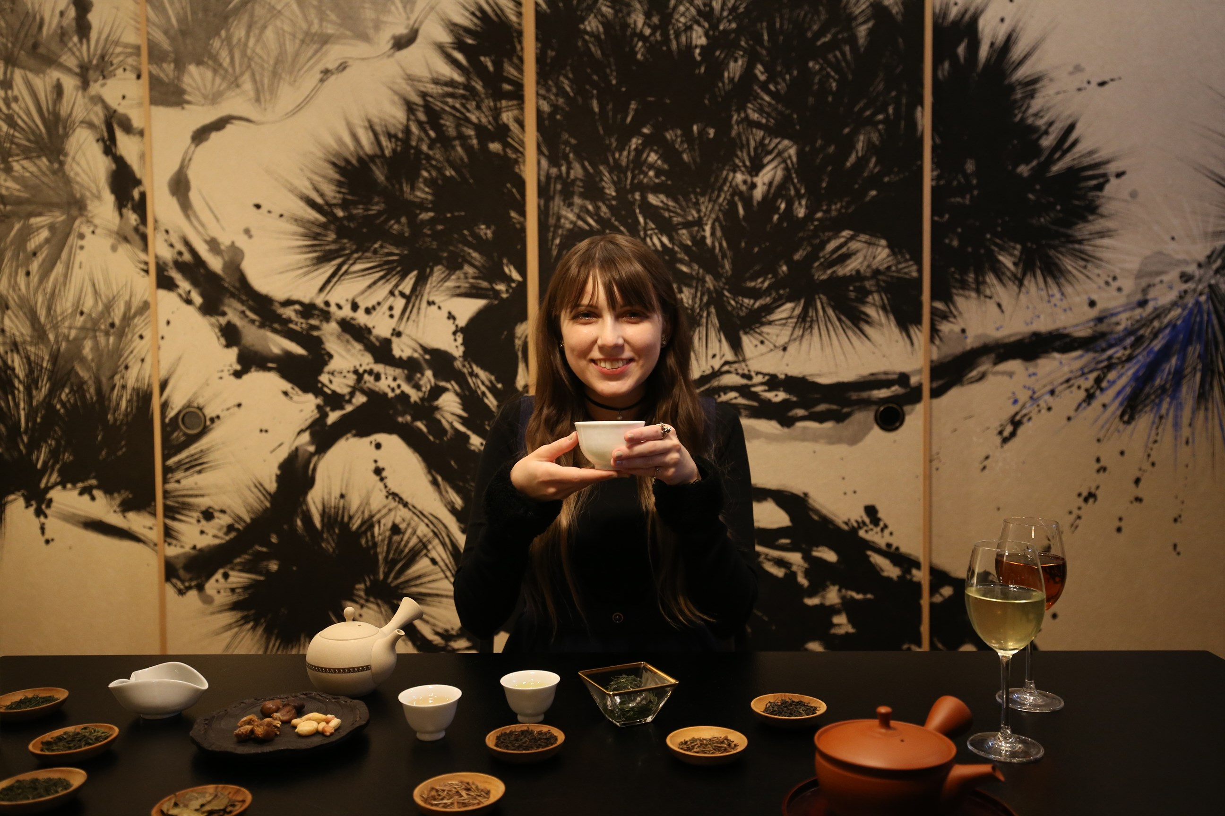
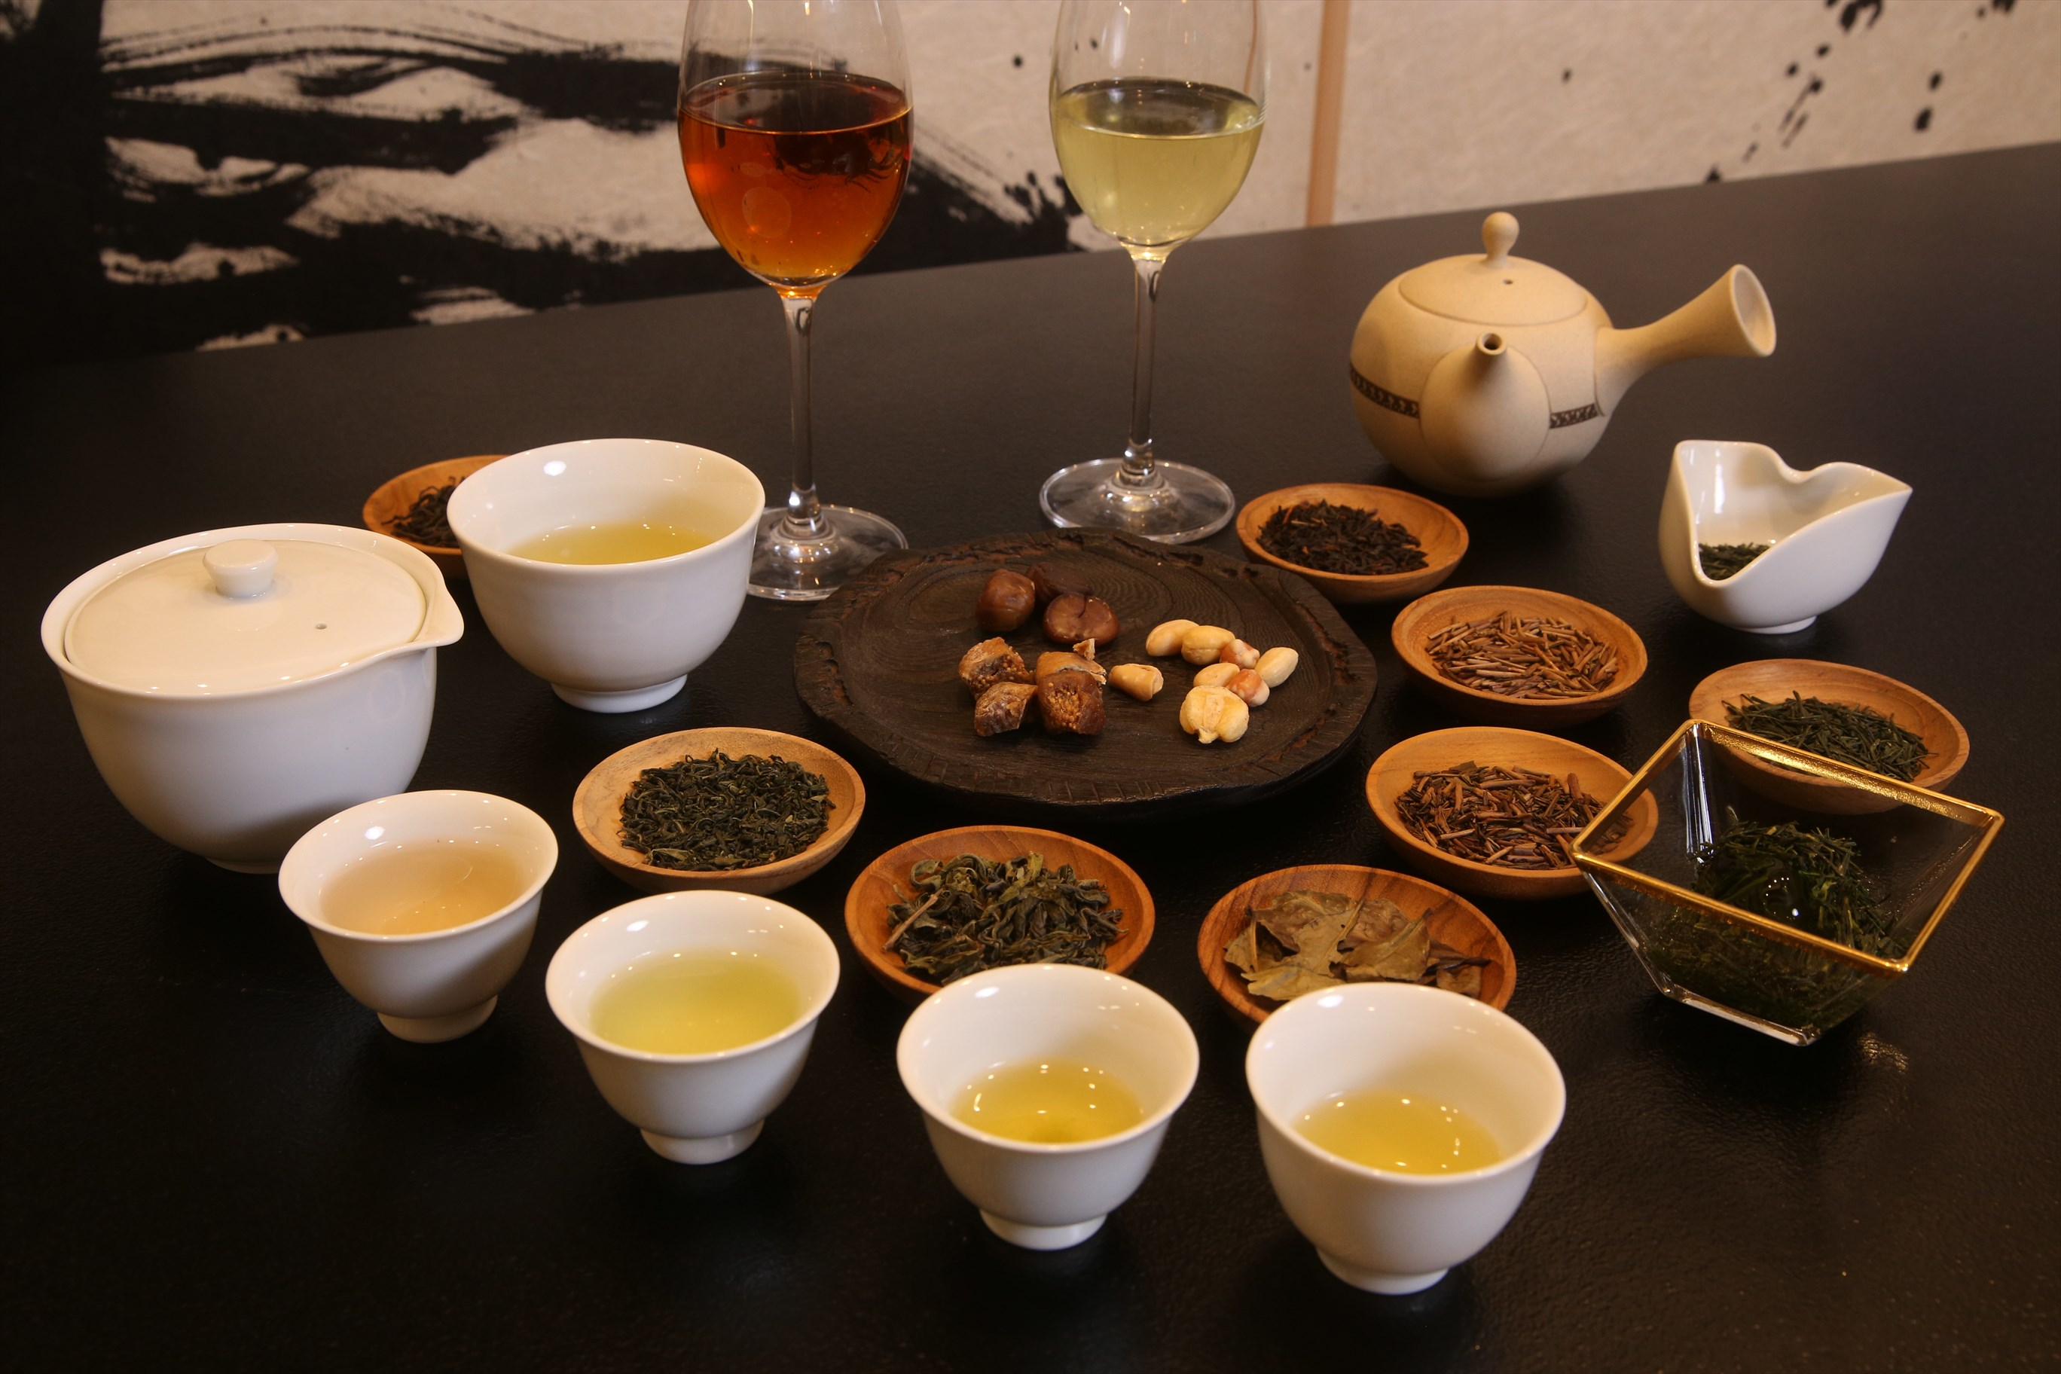
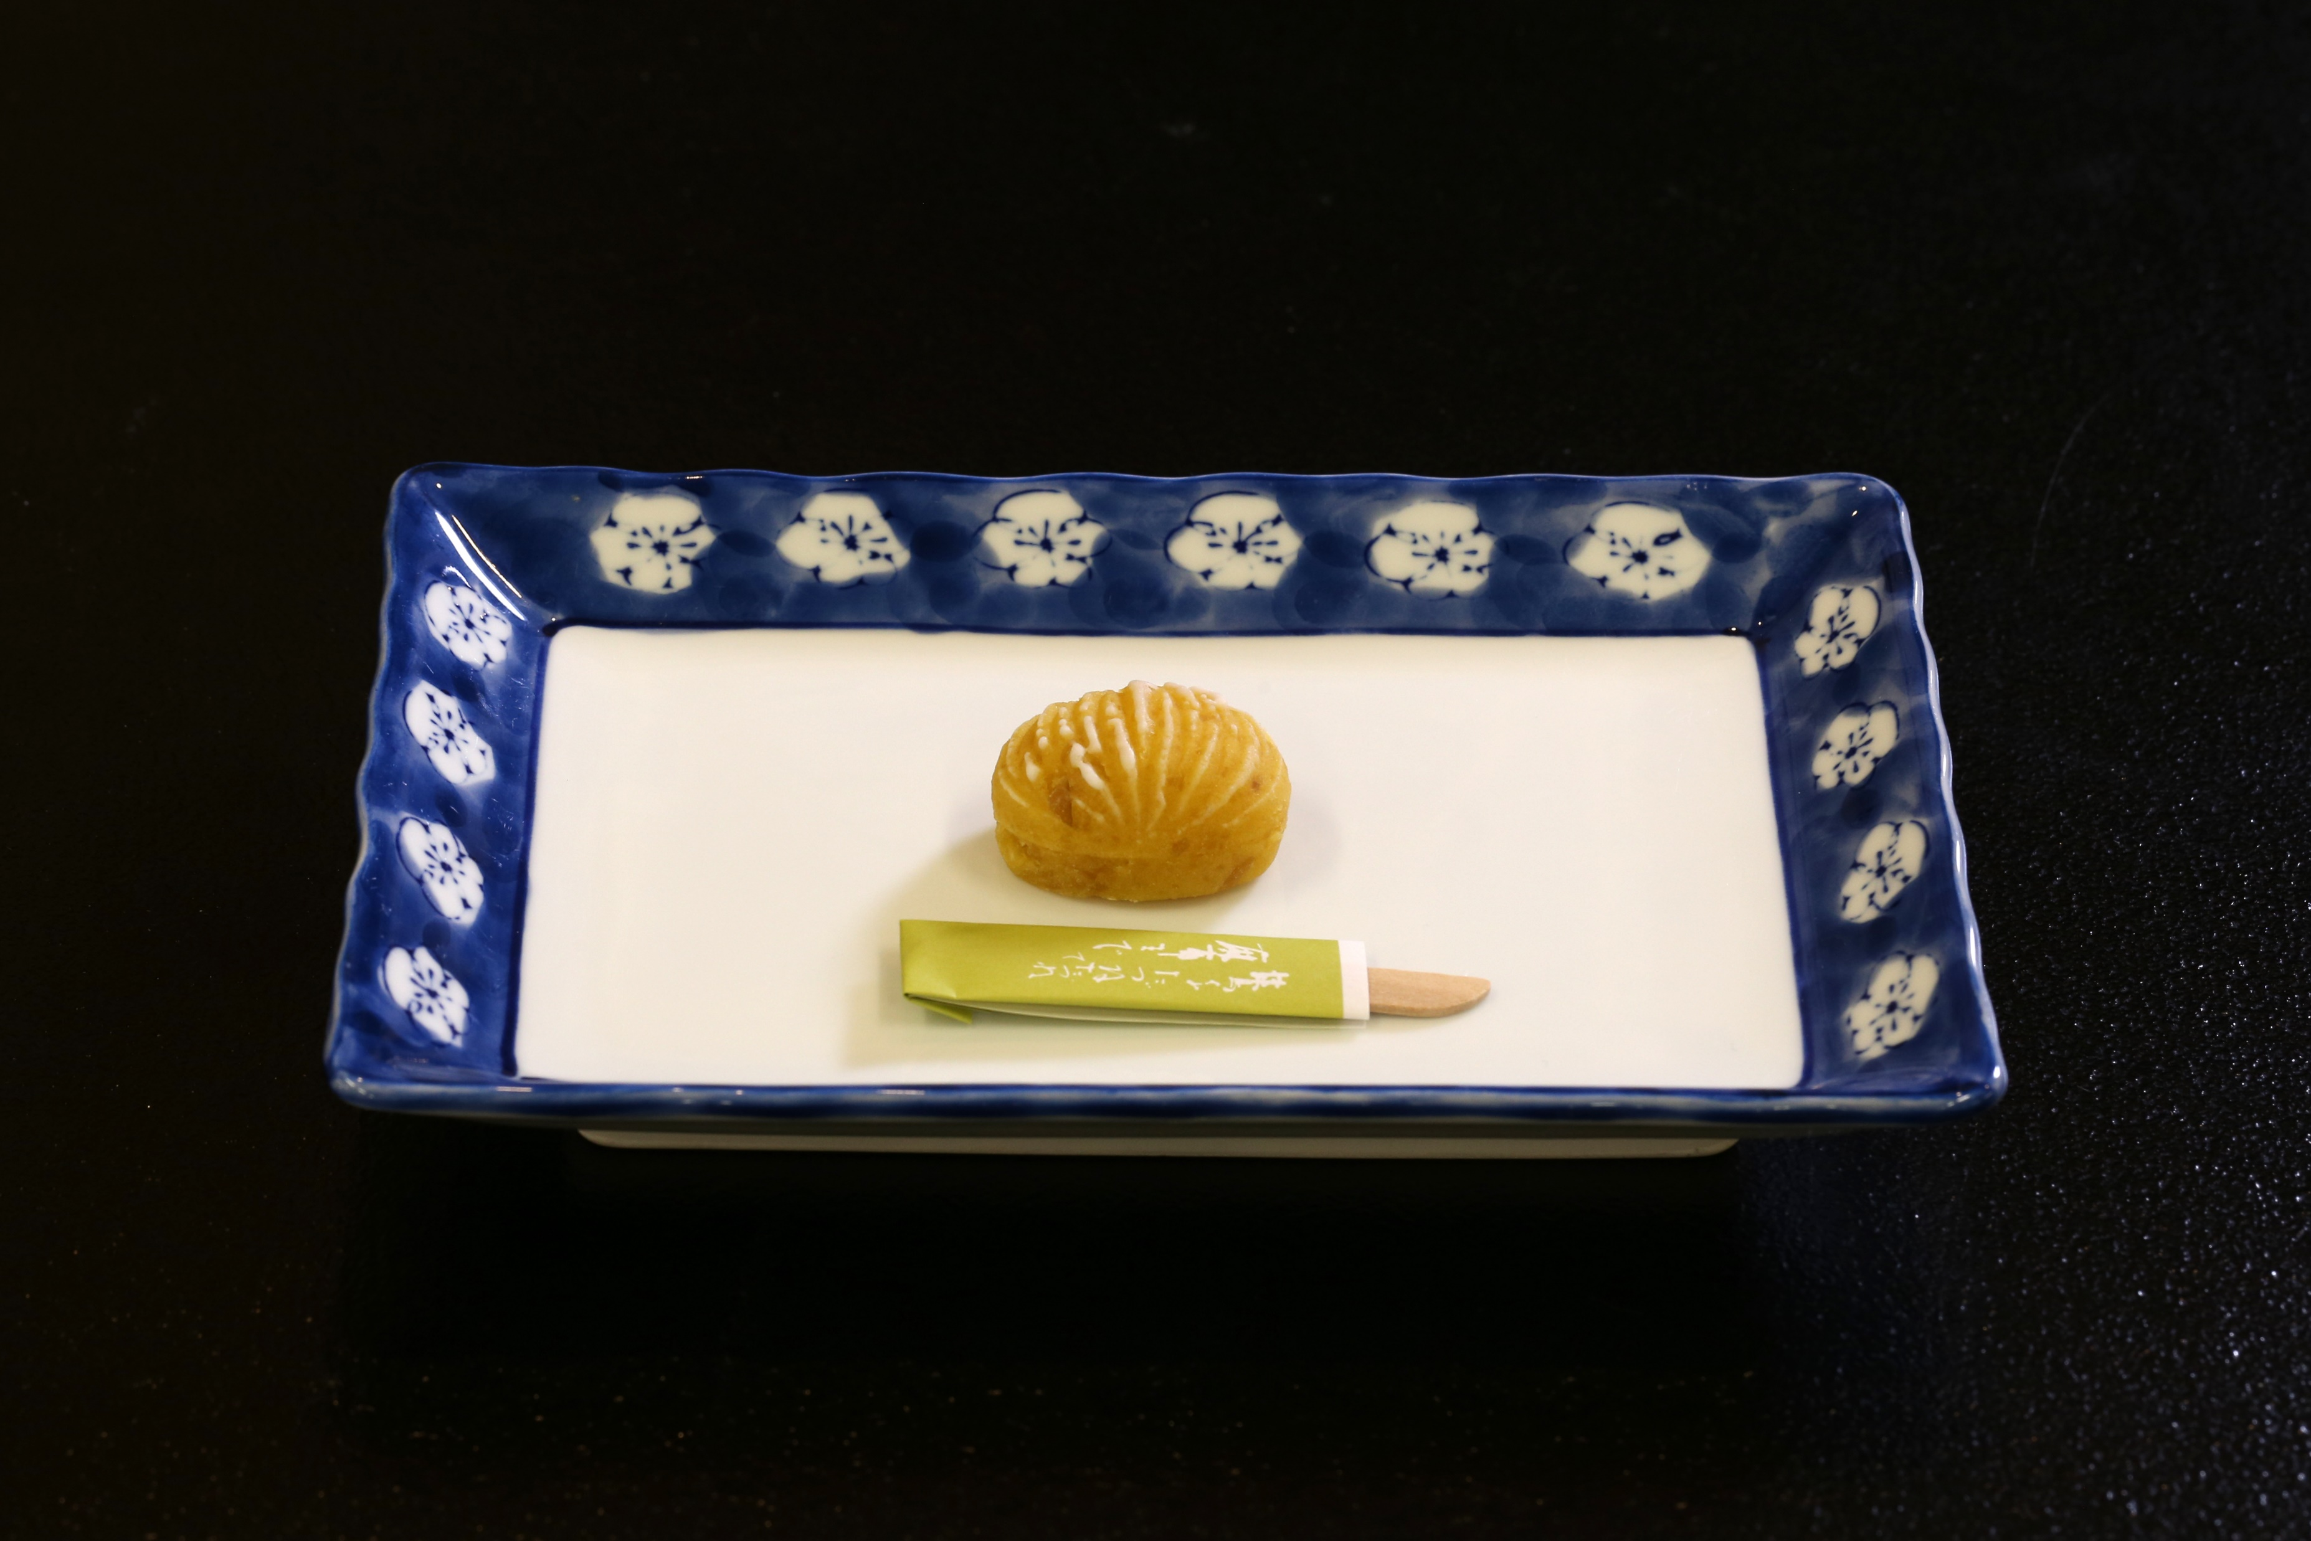
C009 5 Kinds of Japanese Tea Tasting Experience 日本茶5種飲み比べ体験

Slide 7
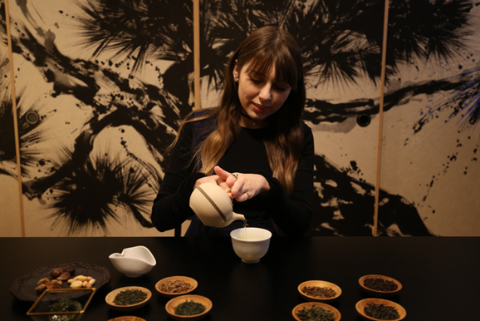
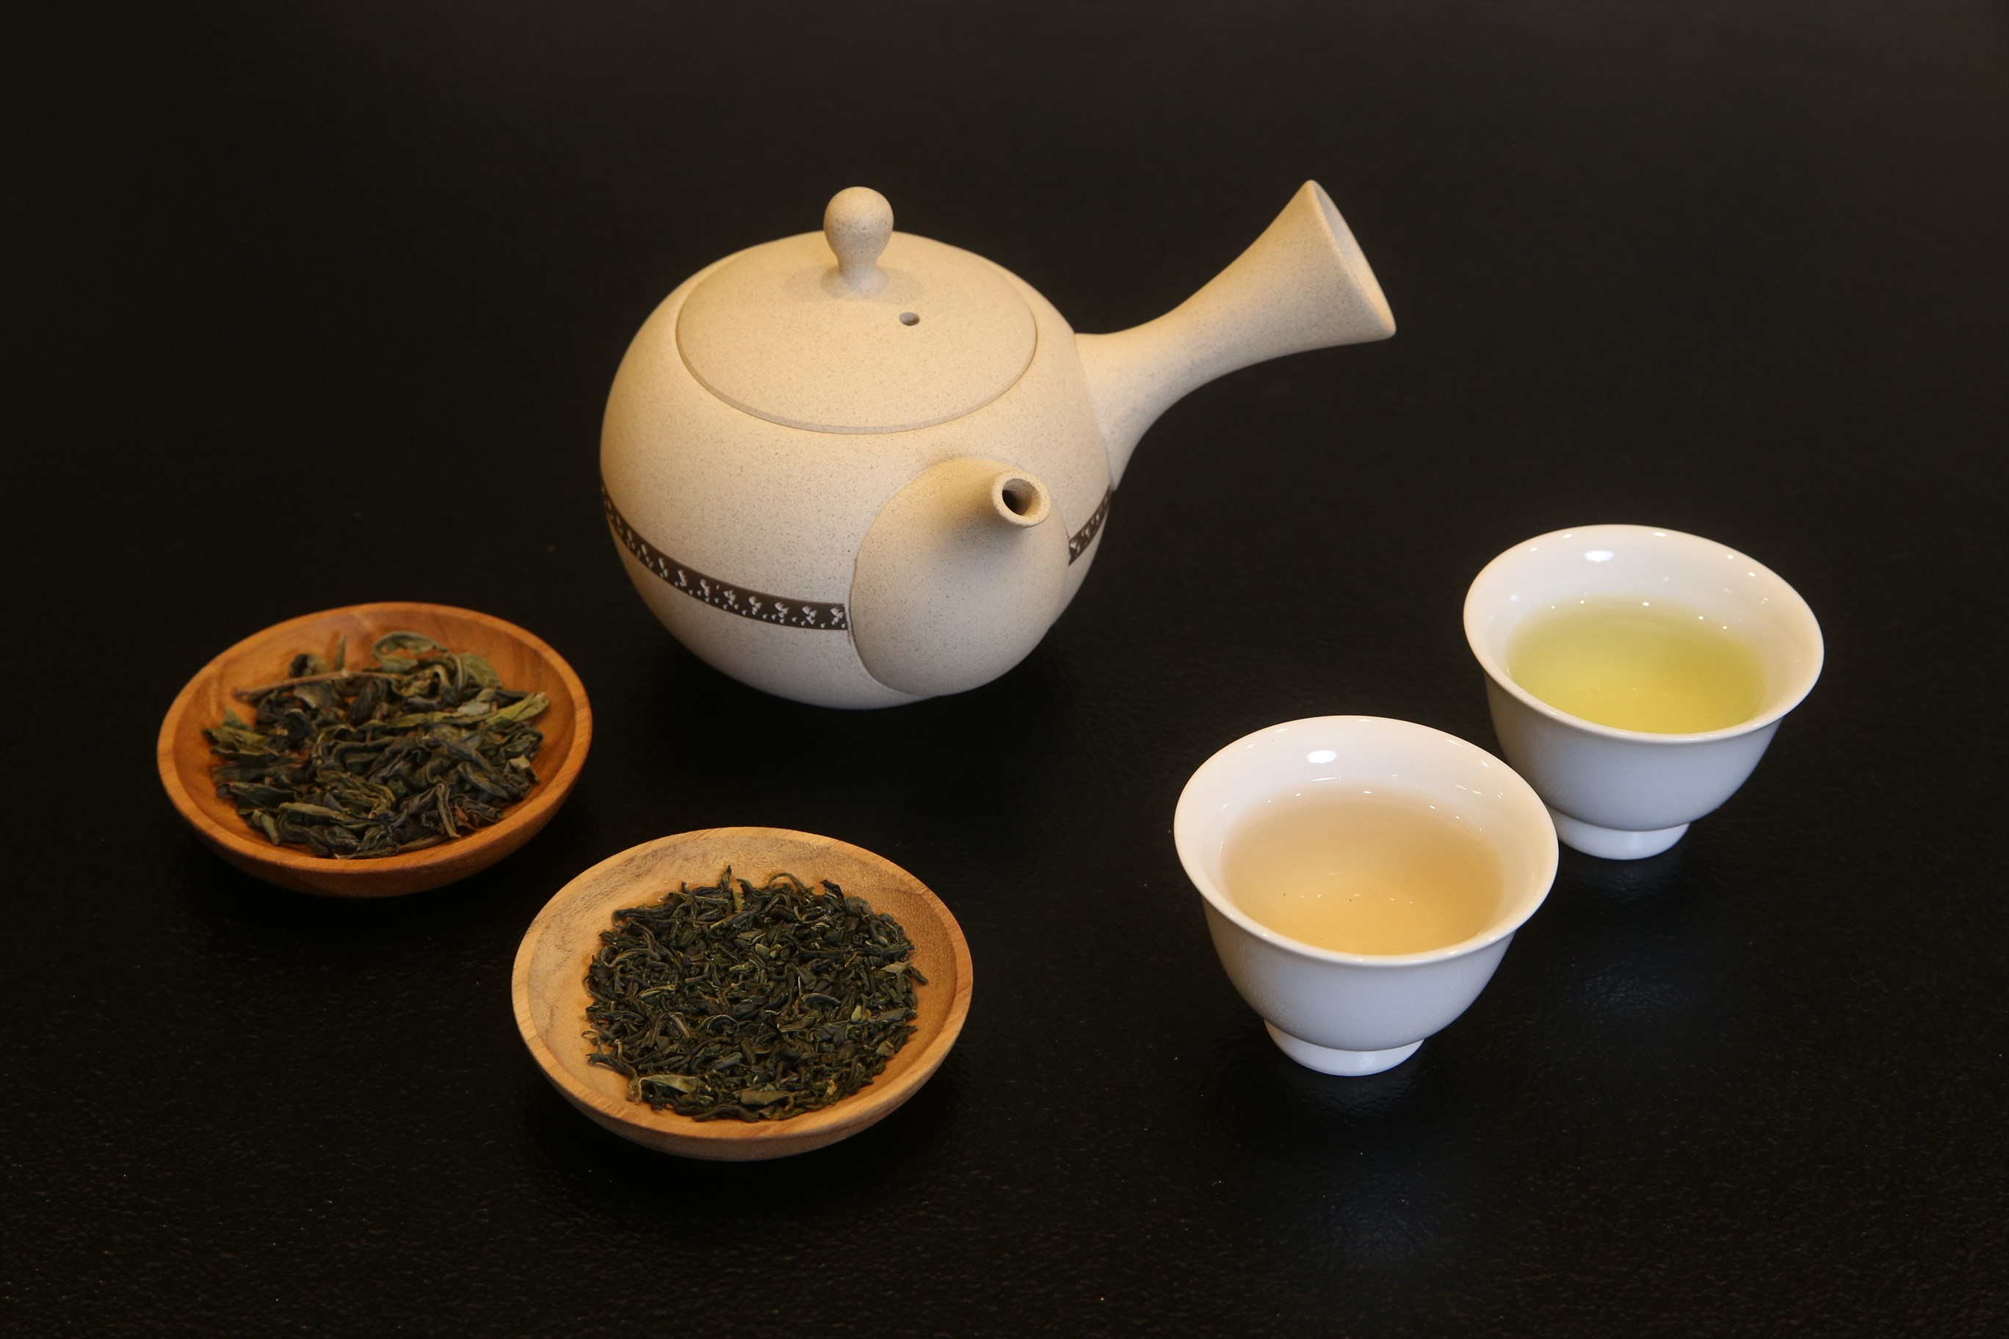
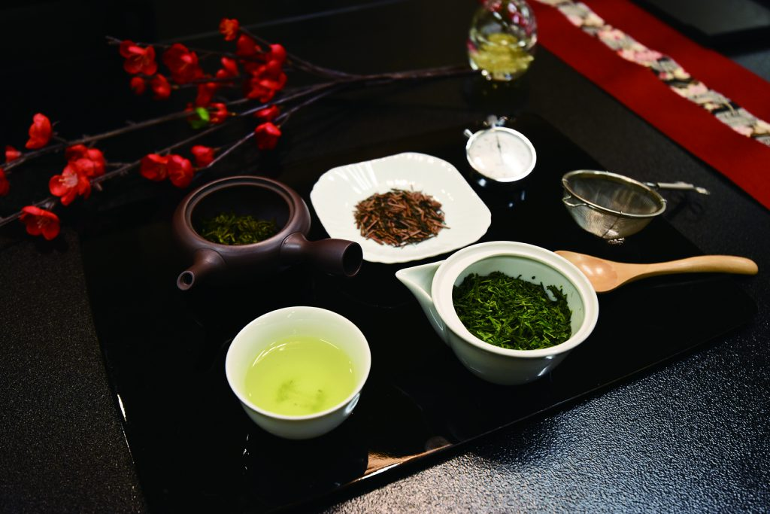
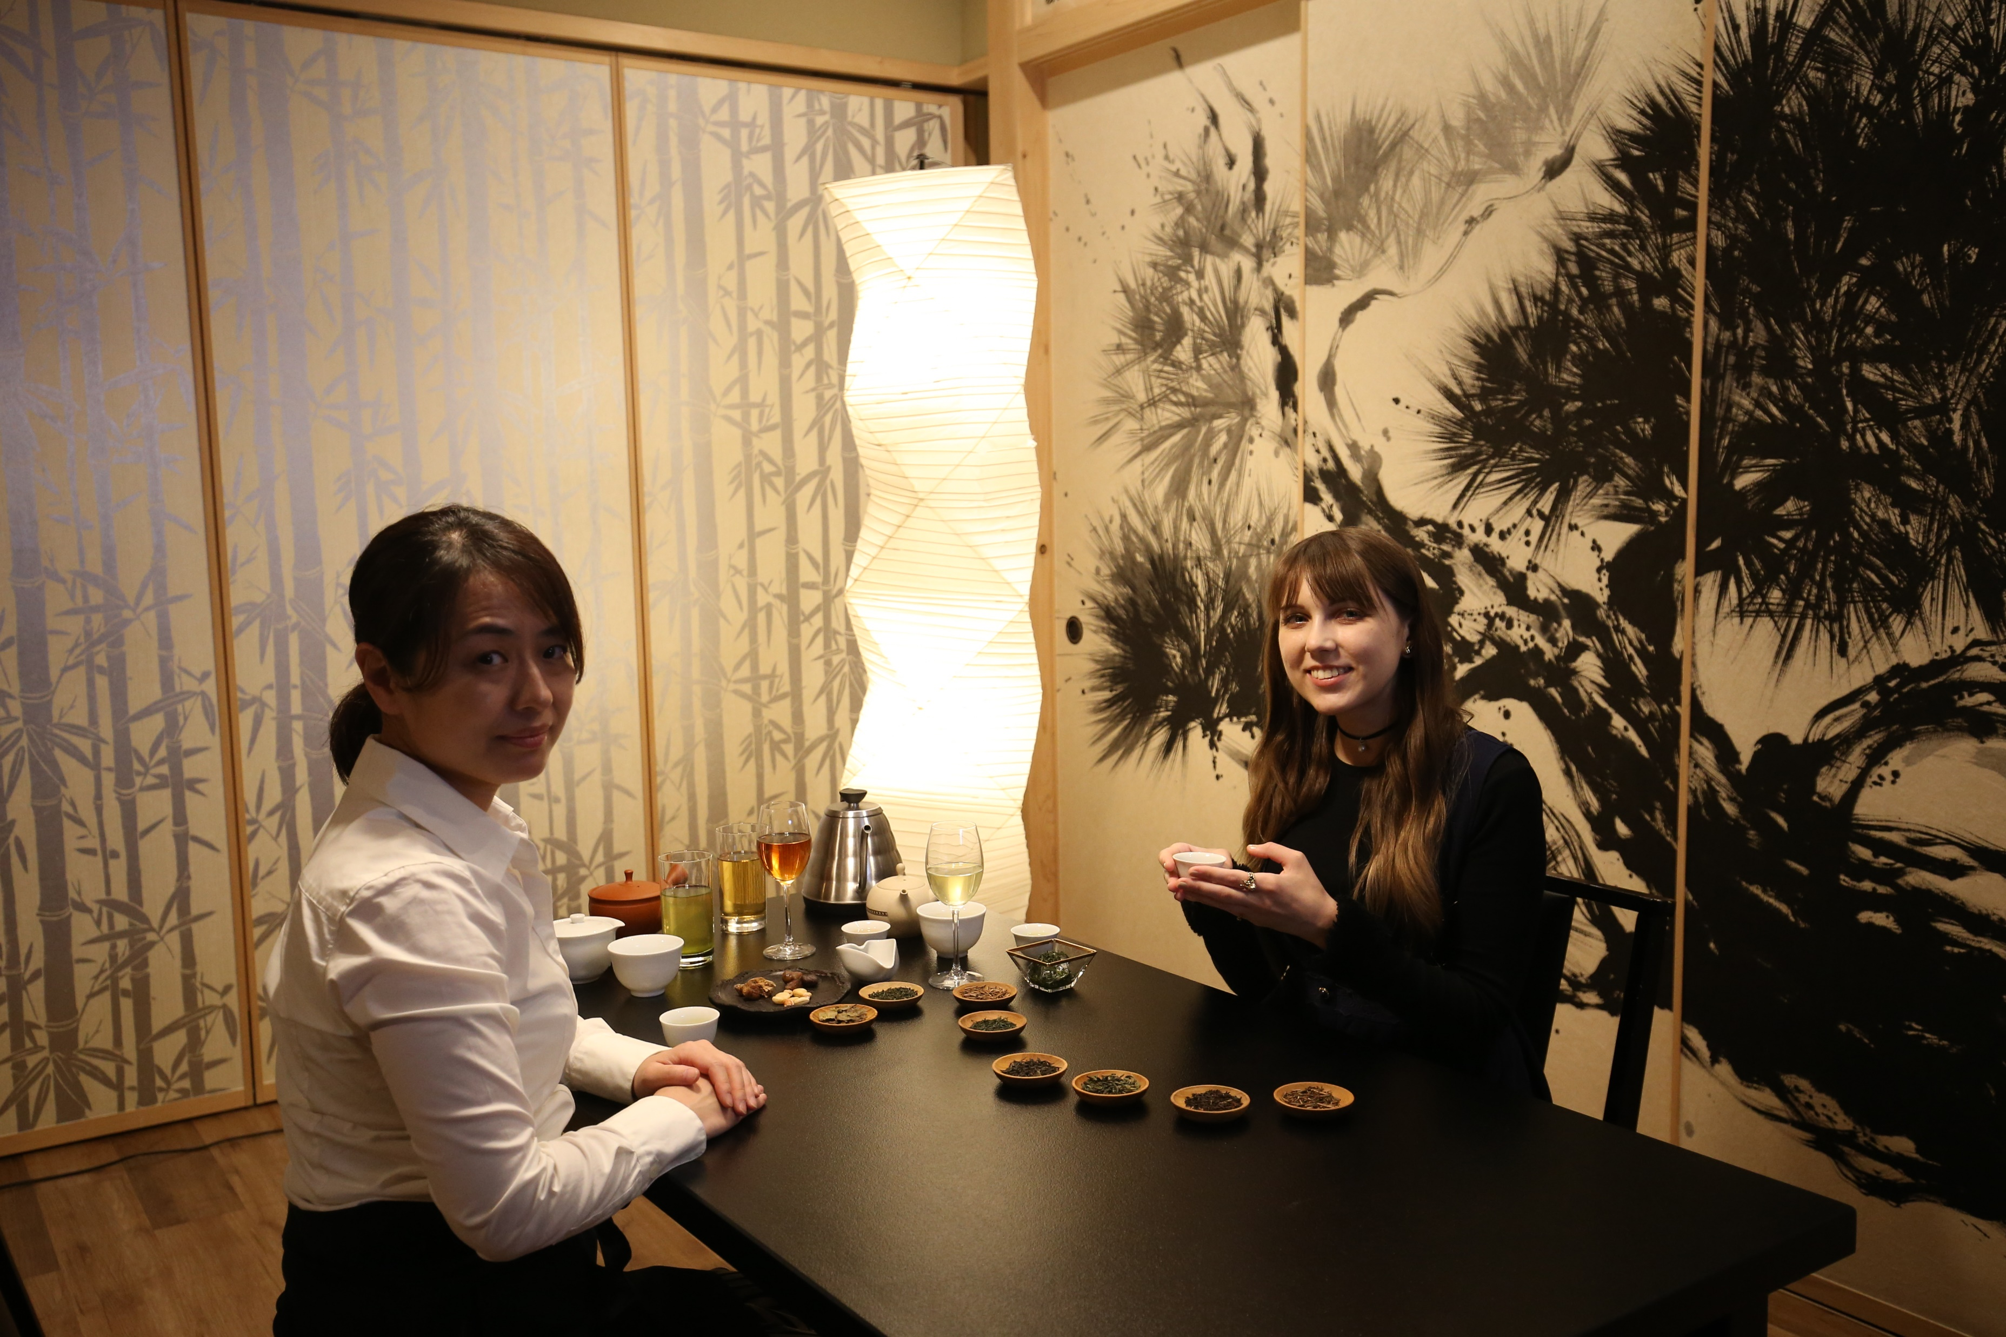
C010 3 Kinds of Japanese Tea Tasting Experience 日本茶3種飲み比べ体験

